Slide 1
The Front End Stack
As of 2019

Slide 2
A brief history of web tech
HTML, CSS, and JavaScript throughout the years

Slide 3
HTML (Hypertext Markup Language)
Plain ol’ HTML files
Preprocessors (PHP, Jinja2, Handlebars)
HTML-in-JS (JSX, Angular, Vue.js)

Slide 4
CSS (Cascading Style Sheets)
External CSS files
Preprocessors (Sass, Less, Stylus)
CSS-in-JS (styled-components, glamor, emotion)
CSS-in-HTML (Inline styles)

Slide 5
JavaScript (the old parts)
One global scope
Namespacing
IIFE (Immediately Invoked Function Expression)
CommonJS modules (Node.js)

Slide 6
JavaScript (the new parts)
ES6 Modules
Dynamic imports
Entering the almighty webpack

Slide 7
webpack
Throwing stuff together (aka module bundler)

Slide 8
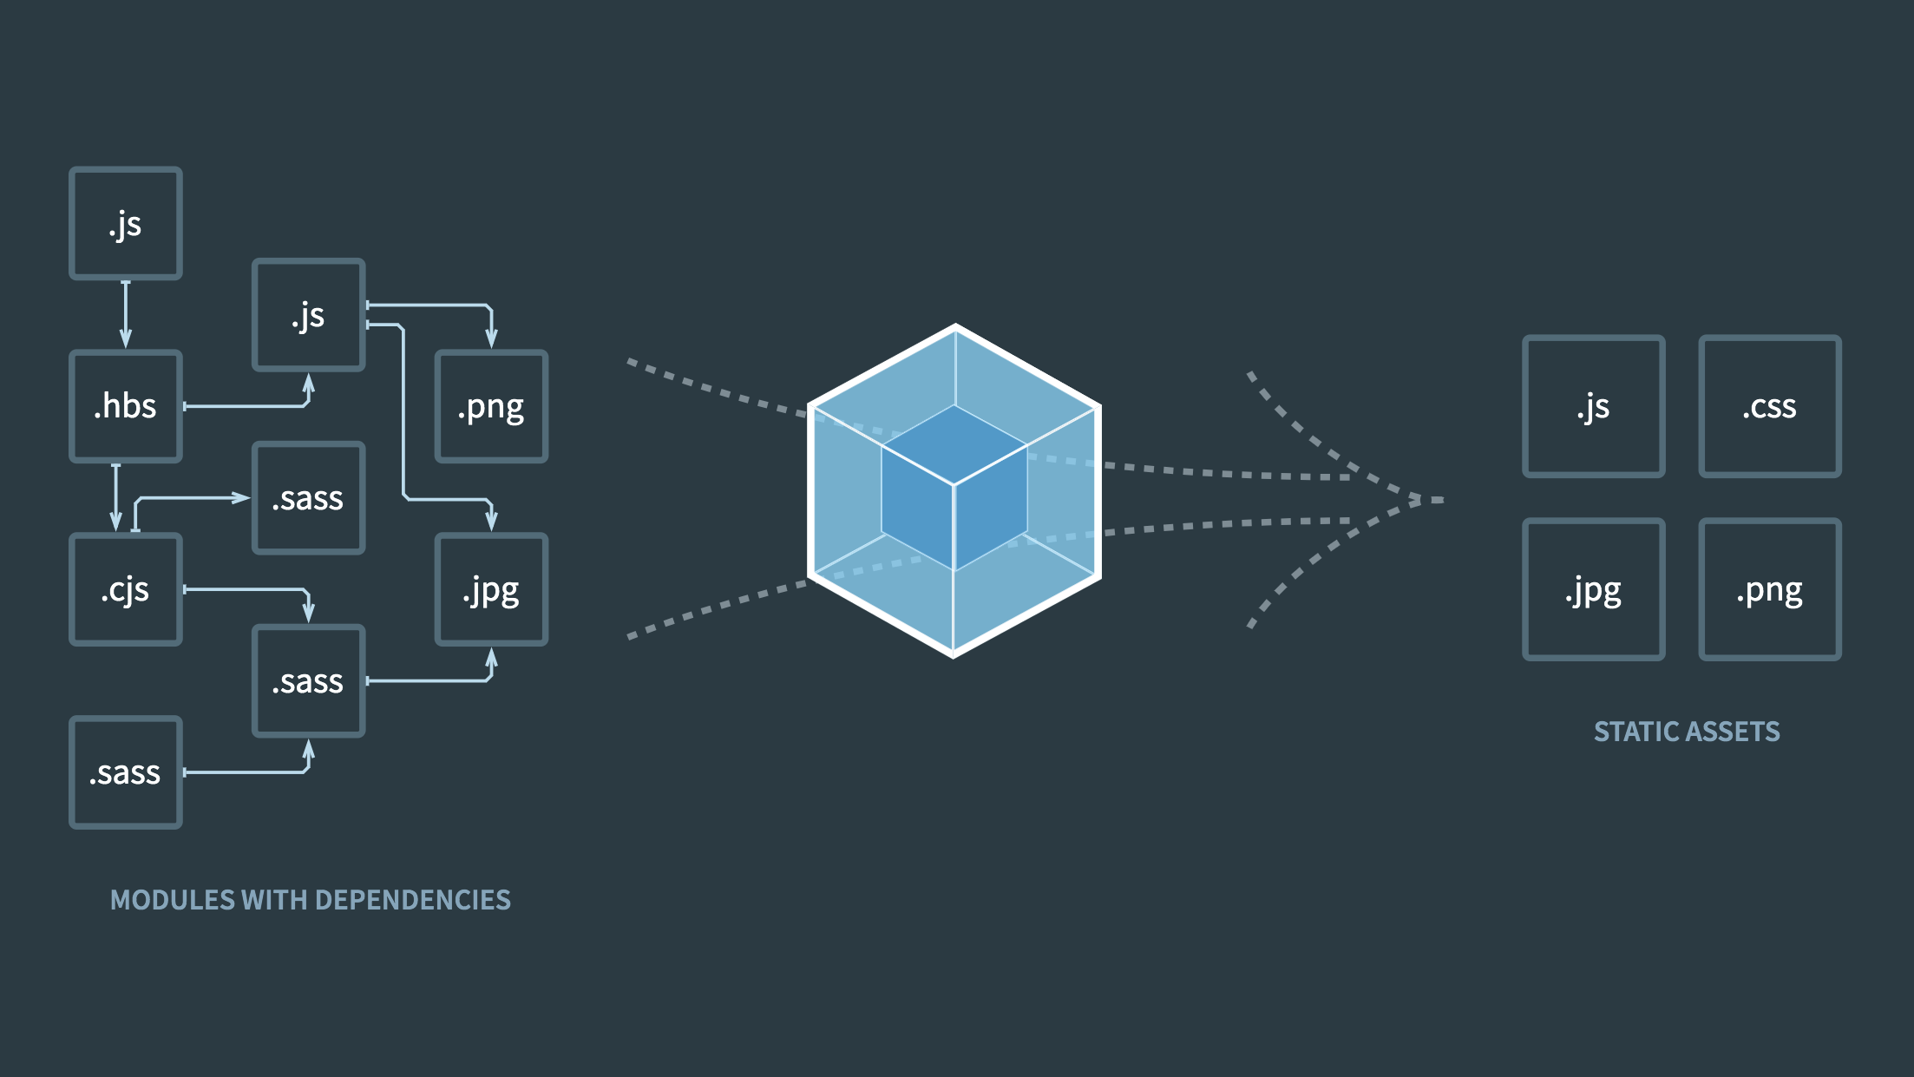

Slide 9

https://www.youtube.com/watch?v=jFc898NTh5Q

Slide 10
Babel
Transform something into usable JavaScript (aka compiler)

Slide 11
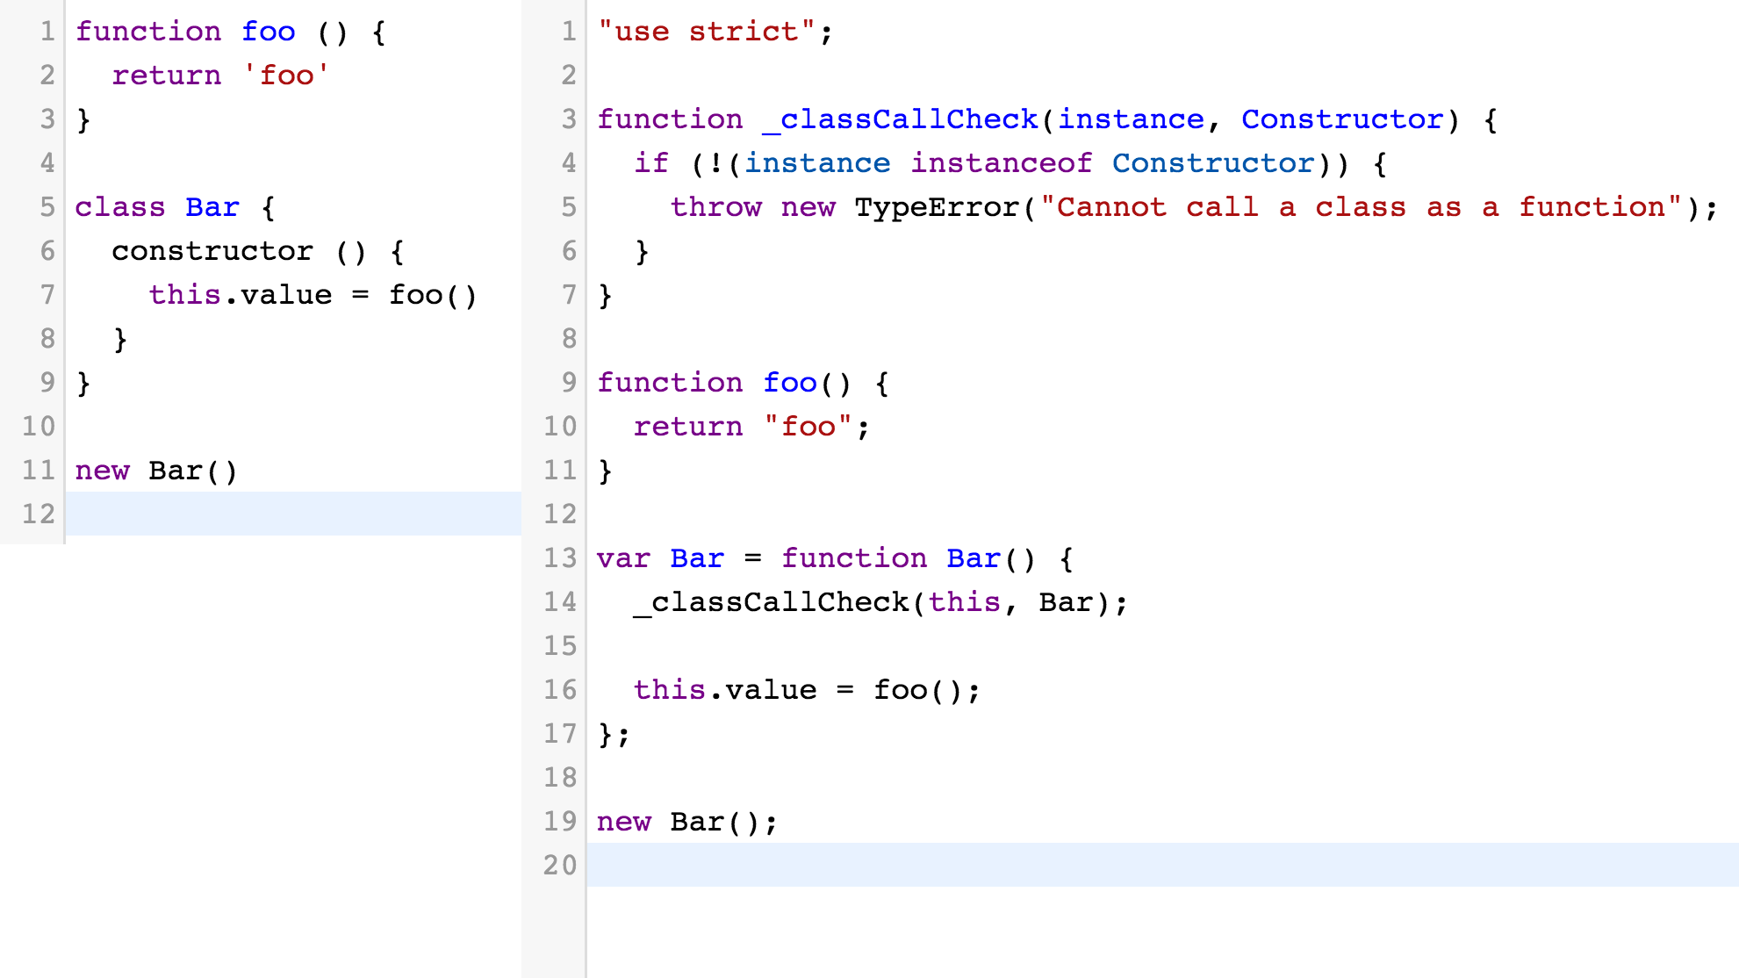

Slide 12
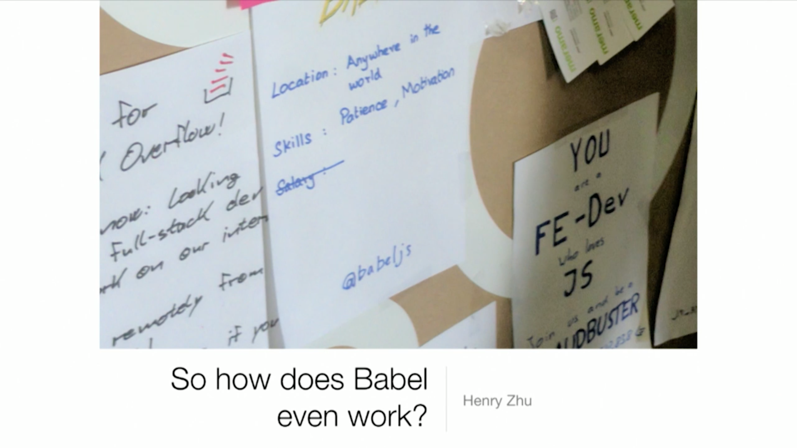
https://www.youtube.com/watch?v=fntd0sPMOtQ

Slide 13
Vue.js
Getting fancy with Single File Components

Slide 14
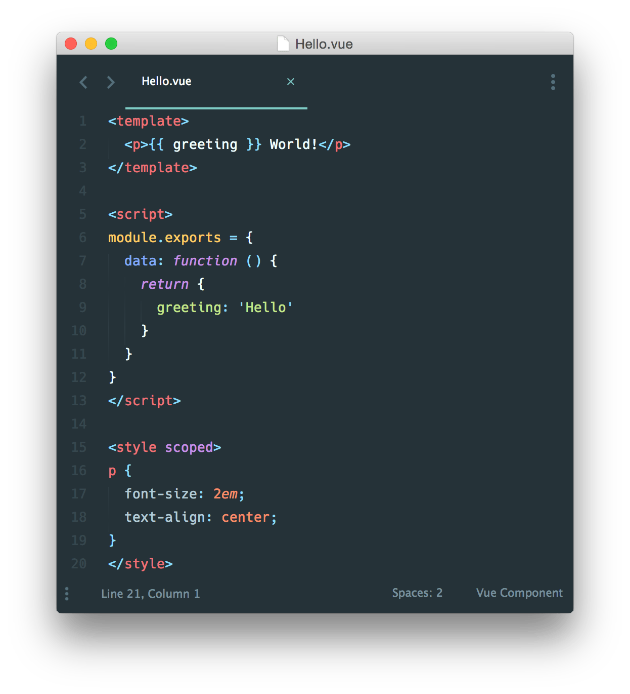

Slide 15
Tree Shaking
Dead-code elimination 🔫

Slide 16
Code Splitting
Create smaller chunks of JavaScript

Slide 17
webpack configs
Putting it all together in an (sometimes) ugly config file

Slide 18
Some examples
Basic
https://github.com/webpack/webpack/blob/master/examples/two-explicit-vendor-chunks/webpack.config.js
Advanced
https://github.com/pangolinjs/core/tree/master/lib/config
Insane
https://github.com/vuejs/vue-cli/tree/dev/packages/%40vue/cli-service/lib/config

